Slide 1
Processor allocation algorithms

Slide 2
Processor allocation algorithms
A distributed system consists of multiple processors & thus some algorithm is needed to decide which process should run on which machine.
Some important algorithms which cover wide range of capabilities include:
Graph-Theoretic
Centralized
Hierarchical
Sender-Initiated
Receiver-Initiated and Bidding

Slide 3
Graph-Theoretic Deterministic algorithm
This algorithm is applicable for systems consisting of processes with known CPU-memory requirements and a known matrix giving the average traffic between each pair of processes.
Idea is to minimize network traffic.
System is denoted as a weighted graph with each node being a process & each arc represents flow of msges between 2 processes.
The problem is reduced to finding a way to partition the graph into k disjoint sub-graphs (with total CPU & memory needs below some limits in each sub-graph) so that network traffic is reduced.
An example shows 2 ways of partitioning the same graph yielding 2 different network loads.

Slide 4
In (a), the graph is partitioned with processes A, E & G on one processor, processes B,F & H on second while processes C, D & I on the third.
The total network traffic is the sum of the arcs intersected by the dotted cut lines (30 units).
AB(3) + BE(2) + GH(4) + EH(4)
+ BC(2) + CF(8) + IF(5) + HI(2) = 30
=============================================================================
In (b), a different partitioning is followed which yields less network traffic (28 units).
AB(3) + BE(2) + GH(4) + EH(4)
+ CI(5) + CD(3) + IF(5) + HI(2) = 28
Assuming that it meets all memory & CPU constraints, option (b) is a better choice since it requires less communication.

Slide 5
Centralized algorithm
Graph based algorithm have limited application as they need complete information in advance.
Centralized algorithm is also called up-down algorithm where the coordinator mantains a usage table with one entry per user. (initially zero).
When a process is to be created & the machine that created it decides that the process is to be run elsewhere, it asks the usage table coordinator to allocate it a processor. If there is one available & no one else wants it, the request is granted. If no processors are free, the request is denied.
When a user is running processes on other user’s machines, it accumulates penalty points which are added to its usage table entry. When it has unsatisfied requests pending, penalty points are subtracted from its usage table entry. When no requests are pending & no processors are being used, the usage table entry is moved a certain no of points closer to zero, until it reaches zero. This way, the score gets up & down and hence the name.
Usage table entries can be positive, negative or zero. A +ve score means that it has surplus resources, -ve score means that it needs resources while a zero score is neutral.

Slide 6
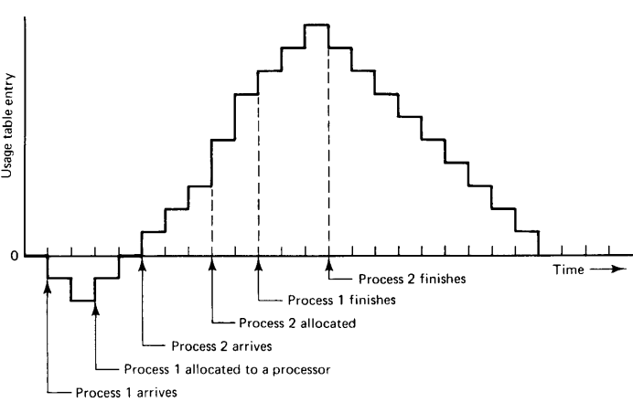
Heuristic used for processor allocation:::::
When a processor becomes free, the pending request whose owner has the least score wins. Thus a user with no processor & who had a longer pending request will win over someone who is using many processors. Thus, the resources are allocated fairly.

Slide 7
Hierarchical algorithm
Centralized algorithms fail to scale well in large systems due to single point of failure.
An hierarchical approach organizes machines like people in corporate where some are workers & others are managers.
For a grp of ‘k’ workers, 1 manager keeps track of machines that are busy/idle. For a large network, multiple managers or sub-managers are asigned as they work in a hierarchy.
If a manager crashes/fails, one of the direct subordinate is promoted as the acting manager & this decision is made by the earlier manager which failed or in an autocratic manner by the earlier manager’s superior.

Slide 8
To avoid a single manager at the top, it can be truncated to have a committee as the ultimate authority. When a member of the rulling commitee malfunctions, the remaining members promote someone one level down as replacement.
If the manager receiving the request think it has very few processors available, it passes the request upward in the tree to its boss. If the boss can’t handle it either, the request continues propagating upward until it reaches a level that has enough available workers at its disposal.
At that point, the manager splits the request into parts & sends them to the managers below it & the process continues until the allocation hits bottom level. At the bottom level, the processors are marked as “busy”.

Slide 9
Sender-Initiated algorithm
When a process is created, the machine on which it originates send probe msges to a randomly chosen machine asking if its load is below certain threshold value.
If so, the process is sent there.
If not, another machine is chosen for probing.
If no suitable host is found within ‘N’ probes, the algorithm terminates & the process runs on the originating machine.
It should be noted that under heavy load, all machines will constantly send probes to other machines in an attempt to find one that is willing to accept more work.

Slide 10
Receiver-Initiated algorithm
Another algorithm exists which is initiated by an underloaded receiver. Here, whenever a process finishes, the system checks to see if it has enough work.
If that machine has nothing to offer then another machine is asked.
If no work is found with ‘N’ probes, the receiver temporarily stops asking, completes any work it has queued up & tries again when the next process finishes.
If no work is available, the machine goes idle & after some interval it starts probing again.

Slide 11
Bidding Algorithm
Another class of algorithms tries to turn the computer system into a miniature economy, with buyers and sellers of services and prices set by supply and demand.
The key players in the economy are the processes, which must buy CPU time to get their work done, and processors, which auction their cycles off to the highest bidder.
Each processor advertises its approximate price by putting it in a publicly readable file.
This price is not guaranteed, but gives an indication of what the service is worth.
Different processors may have different prices, depending on their speed, memory size, presence of floating point hardware, and other features.
An indication of the service provided such as expected response time, can also be published.
When a process wants to start up a child process it goes around and checks out who is currently offering the service that it needs.
It then determines the set of processors whose service it can afford.
From this set, it computes the best candidate, where best may mean cheapest, fastest, or best price/performance, depending on the application.

Slide 12
Cont..
It then generates a bid and sends the bid to its first choice.
The bid may be higher or lower than the advertised price.
Processors collect all the bids sent to them, and make a choice by picking the highest one. the winners and losers are informed, and the winning process is executed.

Slide 13


